Slide 1
Firewalls (Slides: From Internet Source)

Slide 2
Objectives and Deliverable
Understand the concept of firewalls and the three major categories: packet filters (stateless vs. stateful) and application level proxy
Can apply them to detect different attacks
Be able to write the stateless packet filter rules

Slide 3
What is a Firewall?
A Cyber Security Tool to filter traffic.
Interconnects networks with differing trust
Goal of a firewall is to block malicious traffic requests and data packets while allowing legitimate traffic through.
Imposes restrictions on network services
only authorized traffic is allowed
Auditing and controlling access
can implement alarms for abnormal behavior
Itself immune to penetration

Slide 4
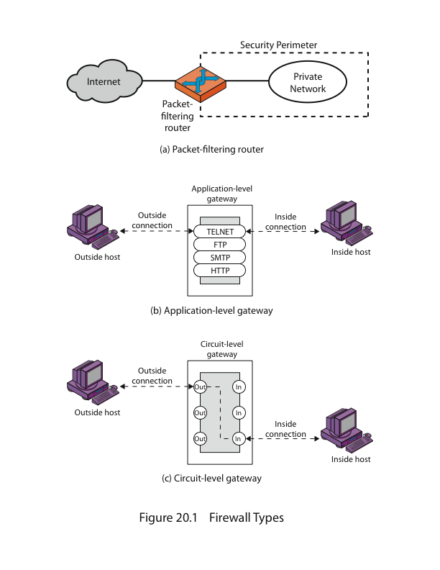
Firewalls – Packet Filters

Slide 5
Classification of Firewall
Characterized by protocol level it controls in
Packet filtering
Circuit gateways
Application gateways

Slide 6
Firewalls – Packet Filters
Simplest of components
Uses transport-layer information only
IP Source Address, Destination Address
Protocol/Next Header (TCP, UDP, ICMP, etc)
TCP or UDP source & destination ports
TCP Flags (SYN, ACK, FIN, etc)
ICMP message type
Examples
DNS uses port 53
No incoming port 53 packets except known trusted servers

Slide 7
Usage of Packet Filters
Filtering with incoming or outgoing interfaces
E.g., Egress filtering of spoofed IP addresses
Ingress filtering
Permits or denies certain services
Requires intimate knowledge of TCP and UDP port utilization on a number of operating systems

Slide 8
How to Configure a Packet Filter
Start with a security policy
Specify allowable packets in terms of logical expressions on packet fields
Rewrite expressions in syntax supported by your vendor
General rules - least privilege
All that is not expressly permitted is prohibited
If you do not need it, eliminate it

Slide 9

Every ruleset is followed by an implicit rule reading like this.

Slide 10

Example 1:
Suppose we want to allow inbound mail (SMTP, port 25) but only to our gateway machine. Also suppose that traffic from some particular site SPIGOT is to be blocked.

Slide 11

Example 2:
Now suppose that we want to implement the policy “any inside host can send mail to the outside”.

Slide 12
Security & Performance of Packet Filters
Degradation depends on number of rules applied at any point
Order rules so that most common traffic is dealt with first
Correctness is more important than speed

Slide 13
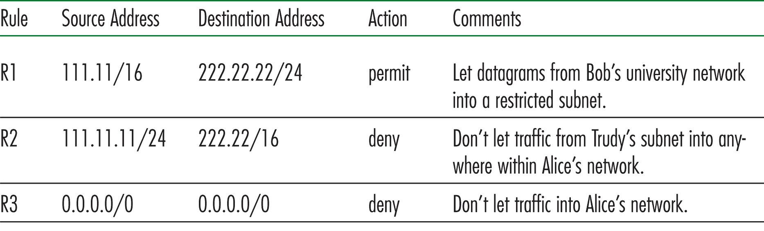
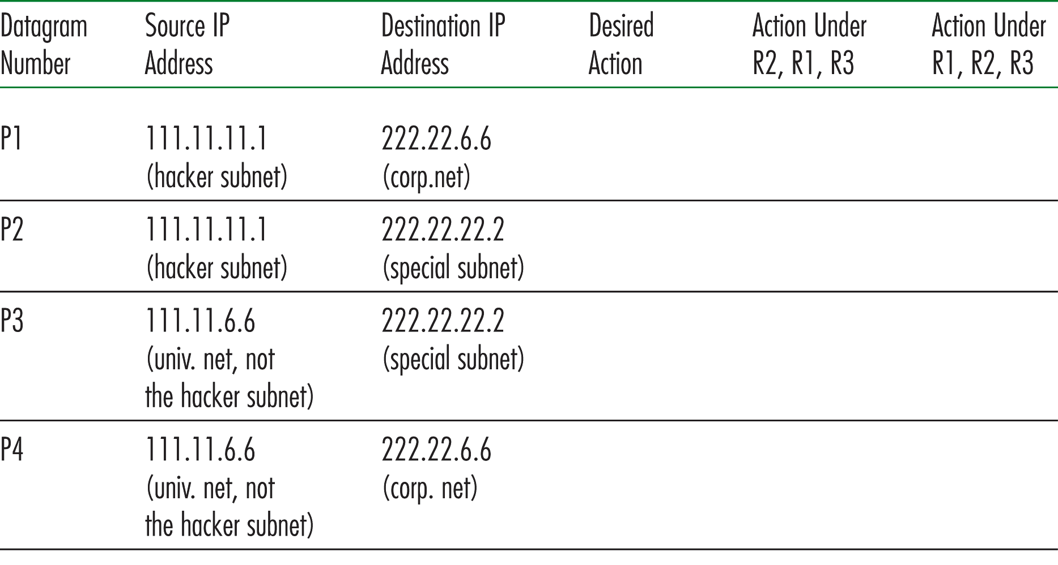
Deny R2
Deny R2
Deny R2
Permit R1
Permit R1
Permit R1
Deny R3
Deny R3

Slide 14
Port Numbering
TCP connection
Server port is number less than 1024
Client port is number between 1024 and 16383
Permanent assignment
Ports <1024 assigned permanently
20,21 for FTP 23 for Telnet
25 for server SMTP 80 for HTTP
Variable use
Ports >1024 must be available for client to make any connection
This presents a limitation for stateless packet filtering
If client wants to use port 2048, firewall must allow incoming traffic on this port
Better: stateful filtering knows outgoing requests

Slide 15
Firewalls – Stateful Packet Filters
Traditional packet filters do not examine transport layer context
ie matching return packets with outgoing flow
Stateful packet filters address this need
They examine each IP packet in context
Keep track of client-server sessions
Check each packet validly belongs to one
Hence are better able to detect bogus packets out of context
Notes:
15
A traditional packet filter makes filtering decisions on an individual packet basis and does not take into consideration any higher layer context. A stateful inspection packet filter tightens up the rules for TCP traffic by creating a directory of outbound TCP connections, and will allow incoming traffic to high-numbered ports only for those packets that fit the profile of one of the entries in this directory. Hence they are better able to detect bogus packets sent out of context.
The context of a connection includes the metadata associated with packets such as:
IP address and port of source and destination endpoints
Last packet received time for handling idle connections
Packet length
Layer 4 TCP sequence numbers and flags
Layer 3 data related to fragmentation and reassembly to identify session for the fragmented packet, etc.
The main difference between a stateful firewall and a stateless firewall is that a stateful firewall will analyze the complete context of traffic and data packets, constantly keeping track of the state of network connections (hense “stateful”). A stateless firewall will instead analyze traffic and data packets without requiring the full context of the connection.

Slide 16
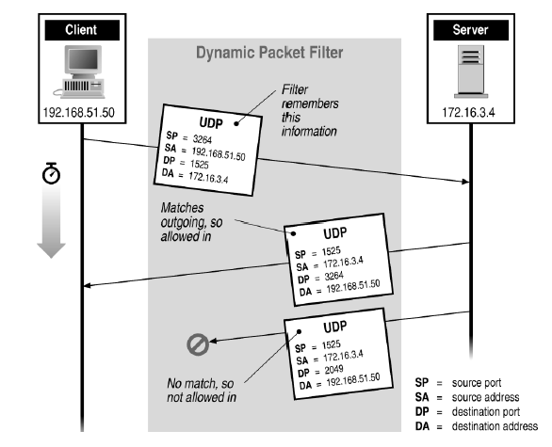
Stateful Filtering
Notes:
Now can you look at this figure and tell me why the first response is allowed while the 2nd not?
The 2nd packet sent had a DP of 2049 which is not the original SP of 3264
16

Slide 17
Example 2(Revisited):
Now suppose that we want to implement the policy “any inside host can send mail to the outside”.

Slide 18
This solution allows calls to come from any port on an inside machine, and will direct them to port 25 on the outside. Simple enough…
So why is it wrong?

Slide 19
Our defined restriction is based solely on the outside host’s port number, which we have no way of controlling.
Now an enemy can access any internal machines and port by originating his call from port 25 on the outside machine.
What can be a better solution ?

Slide 20

The ACK signifies that the packet is part of an ongoing conversation
Packets without the ACK are connection establishment messages, which we are only permitting from internal hosts

Slide 21
Firewall Outlines
Packet filtering
Application gateways
Circuit gateways

Slide 22
Firewall Gateways
Firewall runs set of proxy programs
Proxies filter incoming, outgoing packets
All incoming traffic directed to firewall
All outgoing traffic appears to come from firewall
Policy embedded in proxy programs
Two kinds of proxies
Application-level gateways/proxies
Tailored to http, ftp, smtp, etc.
Circuit-level gateways/proxies
Working on TCP level
Notes:
22
Gateway is like a NAT box, ie, a home router.

Slide 23
Firewalls - Application Level Gateway (or Proxy)

Slide 24
Application-Level Filtering
Has full access to protocol
user requests service from proxy
proxy validates request as legal
then actions request and returns result to user
Need separate proxies for each service
E.g., SMTP (E-Mail)
TELNET (Remote Login)
DNS (Domain Name System)
FTP (File Transfer)

Slide 25
App-level Firewall Architecture
FTP proxy
Telnet proxy
SMTP proxy
Telnet daemon
FTP daemon
SMTP daemon
Network Connection
Daemon spawns proxy when communication detected

Slide 26
Quiz
In this question, we explore some applications and limitations of a packet filtering firewall. For each of the question, briefly explain 1) can stateless firewall be configured to defend against the attack and how?
2) if not, what about stateful firewall ?
3) if neither can, what about application-level proxy?
Can the firewall prevent a SYN flood attack from the external network?
Can the firewall prevent a Smurf attack from the external network? Basically, the Smurf attack uses the broadcast IP address of the subnet.
Notes:
1st question - Stateless cannot, but stateful one can.
2nd question - Yes
3rd question – not present in ppt - No. And hard to get app-level proxy for this, have to listen on many port #s!
No. Yes for app-level gateway.

